Slide 1
Team Savox
CEF-vision system

Slide 2
Table of contents
Design problem
Personas
Customer journey map
Prototype
Evaluation of prototype

Slide 3
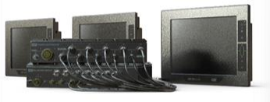
CEF Vision system
Provides vision of the surroundings, cameras and monitors
Used by soldiers when dismounting vehicles
Configuration issue!
How to customize to the monitor views?
Additional monitors, cameras, quad view… ?

Slide 4
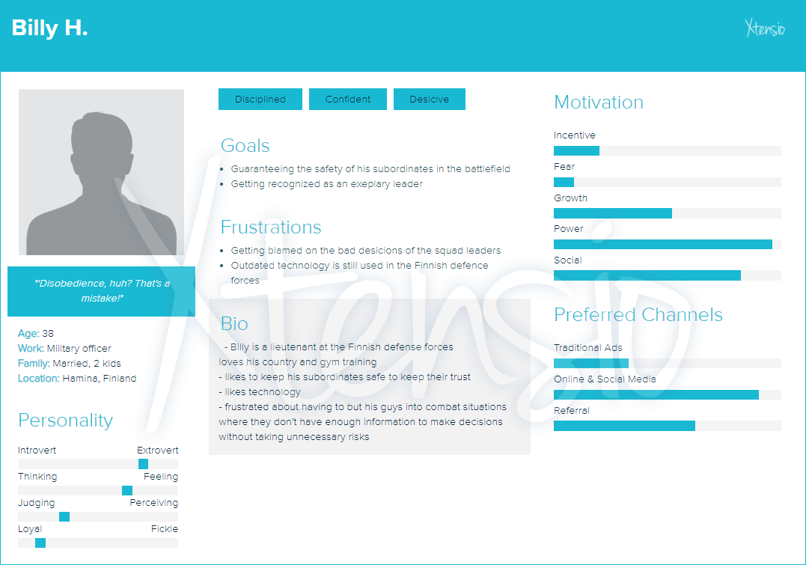

Slide 5
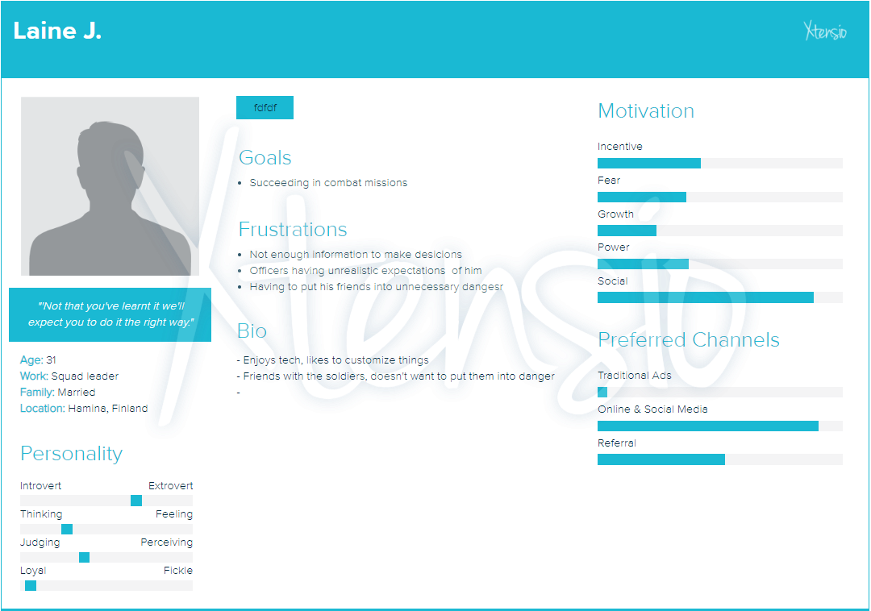

Slide 6
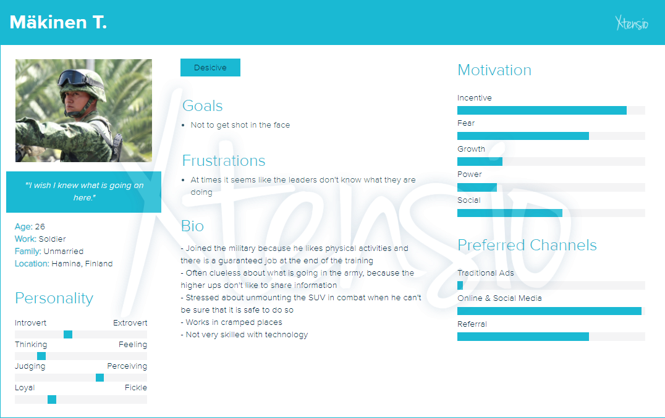

Slide 7
Customer Journey
Create configuration for single view (soldier)
 | Open Software | Navigate to create new configuration | Choose output (screen) to configure | Choose the outputs’s “view” (configuration) to modify | Choose input for selected view (single)
Actions | Find laptop, start software | From home screen, choose “create configuration” (F1) | Navigate to wanted output, select “add configurations” (F1) | Edit “view” with (F2) | Navigate to “edit input” (F1), select input (1-8) → save (F1)
Questions | How to use this? | Can I modify existing configuration? | How do I know which is my preferred screen? What is the current configuration of the screen? | Which inputs are configured to this “view”?
Happy moments |  | This seems easy and fast! | This is simple! Oh, here i can edit output name! | Oh, here I can choose type of the “view”! (single/multi) | Oh, here I can change input name!
Pain points | “There is not a lot of space” |  | All the outputs are named in a confusing manner! | Still cant figure out how the outputs are named!
Opportunities |  |  | Allow naming of outputs | Allow naming of outputs

Slide 8
Customer Journey
Create configuration for multi view (soldier)
 | Open Software | Navigate to create new configuration | Choose output (screen) to configure | Choose the outputs’s “view” (configuration) to modify | Choose view type multiview and modify it | Choose layout for the “view” | Map inputs to desired positions of the layout
Actions | Find laptop, start software | From home screen, choose “create configuration” (F1) | Navigate to wanted output, select “add configurations” (F1) | Edit “view” with (F2) | Navigate to “view type” (F1), select multiview, select “edit multiview” | Scroll between layout designs (F2,F3) | Select “edit layout” → “select input” → save
Questions | How to use this? | Can I modify existing configuration? | How do I know which is my preferred screen? What is the current configuration of the screen? | Which inputs are configured to this “view”? |  | What is suitable for me?
Happy moments |  | This seems easy and fast! | This is simple! Oh, here i can edit output name! | Oh, here I can choose type of the “view”! (single/multi)
Pain points | “There is not a lot of space” |  | All the outputs are named in a confusing manner! | Still cant figure out how the outputs are named! |  |  | I’m not sure which input is which camera, since they haven’t been named!
Opportunities |  |  | Allow naming of outputs | Allow naming of outputs

Slide 9
Prototype
https://marvelapp.com/4e7a0dh/screen/53603764

Slide 10
Visibility of system status
Transitions are instant, so not needed
Real world experience
Keyboard is not the most intuitive way for configuring, but it is mandatory as no other devices are provided. Inputs can be named by location which helps.
User freedom
You can go to previous screen, but there is no “panic exit”
Consistency
Controls are consistent, and just a few exists to provide easy to learn experience
Errors
Not much room for error, as user doesnt input manually much information
Recognition vs. recall
All needed is on the screen
Flexibility and efficiency
Not much shortcuts in design. Maybe copying of presets?
Aesthetics
Barebones UI, no distractions. Primary wish clear, minimal and easy to use UI.
Recovering from errors
As said, not much errors to be made
Help
Self explanatory UI

Slide 11
Cognitive walktrough
UI is designed so that the user doesnt have many possible ways to operate the device, so mistakes rarely happen. Everything is named clearly so interface is intuitive.

Slide 12
More information on the screen
Some kind of help
Testing in car or sth

